Slide 1

Notes to Instructor
Material Needed
Hard copies of the following:
ADaM Model Document v2.1
ADaM IG v1.1
ADaM Data Structure for Occurrence Data v1.0
ADaM Basic Data Structure for Time to Event v1.0
FDA Study Data Technical Conformance Guide
with labelled Post-It notes attached to the first page of each document
Each participant will need to bring their laptop to access workshop templates needed to complete workshop exercises
Excel file Exercise Templates and additional electronic resources on the External SharePoint site

Slide 2
Electronic Documents Required
ADaM Workshop Module 4.pptx (this power point)
Participants will need the following for exercises:
Lilly ADaM Mod 4 Exercise.xlsx
For Reference:
ADaM Model Document v2.1
ADaM IG v1.1
ADaM Data Structure for Occurrence Data v1.0
ADaM Basic Data Structure for Time to Event v1.0
FDA Study Data Technical Conformance Guide

Slide 3
Lilly Workshop Module 4 Common ADaM Variables and The ADaM Basic Data Structure

Slide 4
Objectives
Encourage participation to enhance learning in this hands-on workshop
Identify variables that are common to many analysis datasets including variables to support data point traceability
Recognize the primary features and rules of the ADaM Basic Data Structure (BDS)
Understand the proper use of the BDS variables
Be familiar with the Lilly standard templates that govern the creation of common BDS datasets

Slide 5
ADaM Variables Common to Many Classes

Slide 6

Commonalities Across Structures
There are 2 types of variables that could appear in any analysis dataset
Sponsor defined subject level variables that will appear in most analysis datasets
Example: USUBJID
ADaM standard variables that are applicable for multiple structures
Examples: TRTP, TRTA, SAFFL

Slide 7
Subject Level Variables
When creating analysis datasets, subject level variables from ADSL are included as needed for analysis
For example: ITTFL, TRTSDT
The precise list of subject level variables for a given study will determined by the study team based on analysis need
Notes:
Bottom line is that nearly all AD’s have a set of variables that come from ADSL and are included for analysis and/or support
There is a set of variables but not a set that is intended to be in every data set every time.

Slide 8
ADaM Timing Variables

Slide 9

SDTM versus ADaM Timing Variables
SDTM timing variables describe the protocol specified time point at which data were collected
ADaM timing variables reflect the way the SAP describes time points and may involve visit windowing.
ADaM variables should always be used for analysis

Slide 10
ADaM Timing Variables
Variables for describing the analysis time point of a given row
ADaM Variable | Description
AVISIT | Text variable that describes the visit used to analyze the record
ATPT | Text variable that describes the time point within the visit that a record was analyzed
ADT, ADTM | The date or datetime associated with AVAL
ADY | The analysis day associated with AVAL. Is consistently defined for all analysis datasets using a reference date

Slide 11
SDTM versus ADaM Timing Variables
Reasons these may differ with examples
Descriptive Text
‘Visit 3’ in SDTM → ‘Month 3’ in ADaM
Visit Windows
‘Week 5’ in SDTM → ‘Week 6’ in ADaM
Imputing Missing Visits
‘Month 6 Endpoint’ in ADaM
New Time Point
‘Month 2’ in SDTM carried forward to impute ‘Month 3’ in ADaM

Slide 12
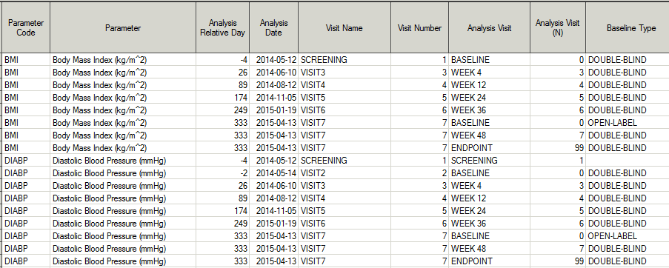
Timing Variables in a Dataset
Notes:
Mario needs to update this data to show real “week” values….show how VISIT is different than AVISIT

Slide 13
ADaM Timing Variables
Variables for describing a higher-level analysis time frame of a set of rows
ADaM Variable | Description
APERIOD | Used to describe a span of time that is associated with a given treatment
APHASE | Used to describe a span of time that may be associated with one or more values of APERIOD or other periods of time

Slide 14
Treatment Variables

Slide 15
ADSL and APERIOD Recap
Recall from Module 3: In ADSL we define TRTxxP variables for every ‘xx’ treatment period
We analyze a set of records that fall within an Analysis Period (APERIOD) with a given treatment
The start and stop dates of a treatment period can differ from the start and stop dates of an analysis period
Notes:
Add in reminder that dates of aperiod and trtperiod can differ

Slide 16
ADSL and APERIOD Recap
We cannot define more analysis periods than we have treatment periods
If TRT01P, TRT02P, TRT03P are defined in ADSL, then APERIOD can only take on values of 1, 2, or 3
Notes:
Add in reminder that dates of aperiod and trtperiod can differ

Slide 17
Treatment Variables in non-ADSL
Non-ADSL datasets using BDS and other structures generally have multiple records per subject and may have more than one value of APERIOD
We may wish to summarize a given record more than once under different treatments. For example, analyze open label records twice::
Summarizing using open label treatment
Summarizing using sequence of treatments from DB and OL

Slide 18
A Study with 2 APERIODs
USUBJID | APERIODC | APERIOD | AVISIT | ..analysis variables… | TRT01P | TRT02P
123-1001 | DB | 1 | Baseline | … | Placebo | Active
123-1001 | DB | 1 | Month 1 | … | Placebo | Active
123-1001 | DB | 1 | Month 2 | … | Placebo | Active
123-1001 | DB | 1 | Month 3 | … | Placebo | Active
123-1001 | OL | 2 | Month 1 | … | Placebo | Active
123-1001 | OL | 2 | Month 2 | … | Placebo | Active
123-1001 | OL | 2 | Month 3 | … | Placebo | Active
Records in DB period are analyzed with TRT01P
Records in OL period are analyzed with TRT02P

Slide 19
Record Level Treatment Variables
USUBJID | APERIODC | AVISIT | ..analysis variables… | TRTP
123-1001 | DB | Baseline | … | Placebo
123-1001 | DB | Month 1 | … | Placebo
123-1001 | DB | Month 2 | … | Placebo
123-1001 | DB | Month 3 | … | Placebo
123-1001 | OL | Month 1 | … | Active
123-1001 | OL | Month 2 | … | Active
123-1001 | OL | Month 3 | … | Active
TRTP – a record level treatment variable used to indicate the value of treatment used for the analysis of that record
Notes:
In the core standards TRTxxP are not included in AD’s. Just say this is an example for discussion purposes and is something that can be done

Slide 20
Choices for Treatment Variables
If TRTP exists, the value has to match a value of a treatment variable in ADSL. This can include the treatment sequence variables
The value of TRTP does not have to correspond to the value of TRTxxP defined by the value of APERIOD on that record
Other ADSL treatment variable can be copied into an AD if needed
TRTA can be defined as well
Talk with your ADaM SME if there is a treatment variable you need but don’t see it in the standard
Notes:
Add that lilly core standards use TRTP. Study teams can add additional variables *if needed*
Show data examples along with these concepts

Slide 21
Data Point Traceability Variables

Slide 22
Achieving Traceability
Recall in Module 1, the importance of traceability was discussed
There are two ways to achieve traceability:
Metadata Traceability - required
Data point Traceability – advisable where feasible

Slide 23
Data Point Traceability
Data Point Traceability Defined:
Achieved by retaining variables or records which will provide a link between the analysis data values back to their source data

Slide 24
Data Point Traceability
When the source data are SDTM, the following variables are good candidates for providing data point traceability:
xxSEQ
VISIT
EPOCH
xxSTRESC when imputation is done for missing xxSTRESN
xxSTDTC when imputation is done

Slide 25
Data Point Traceability
It is advisable to keep all records from SDTM that were candidates for analysis
Use ANLzzFL to indicate records used for analysis versus those that are included for support

Slide 26
The ADaM Basic Data Structure

Slide 27
The Basic Data Structure
In the last module, we learned that the Basic Data Structure is a Class of ADaM structures
What makes it a recognized structure?
What is basic about it?

Slide 28
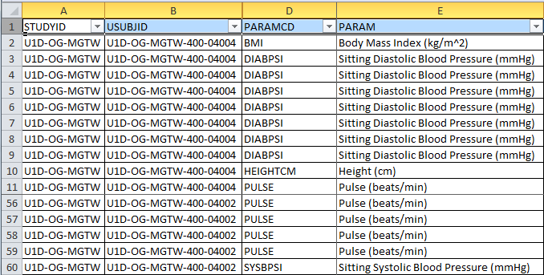
Concept of Analysis Parameter
BDS is characterized by the concept of an analysis parameter (PARAM)
In simple terms, an analysis parameter is text variable that uniquely describes a group of related variables that share a common concept
As the term suggests, an analysis parameter is something that is analyzed

Slide 29
Every PARAM has a Value
PARAM describes an analysis concept
The required variable AVAL (numeric) or AVALC (character) contain the value of the PARAM for the record
USUBJID | AVISIT | PARAM | AVAL
ABC123-01-00001 | Baseline | Serum Glucose (mg/dl) | 115
ABC123-01-00001 | Week 2 | Serum Glucose (mg/dl) | 92
ABC123-01-00001 | Month 1 | Serum Glucose (mg/dl) | 140
ABC123-01-00001 | Month 2 | Serum Glucose (mg/dl) | 123

Slide 30
How to Recognize BDS
The focus of each record in a BDS dataset is captured by the paired variables of PARAM and PARAMCD
The value of the parameter is captured by the variable AVAL (numeric) and/or AVALC (character)
A BDS dataset is therefore characterized by the presence of PARAM, PARAMCD, AVAL / AVALC

Slide 31
Variable Concepts Beyond AVAL
What other variable concepts might be important for the analysis of a parameter?
A categorical grouping of the continuous value (AVAL)
The date it was collected
Whether the value of a specified threshold was observed
The baseline value
The change from baseline value
Indication of whether the value of the parameter was derived

Slide 32
PARAM + AVAL + other columns
Other columns that relate to the concept in PARAM can be added to BDS
The ability to add columns related to PARAM is what makes BDS powerful and flexible
There are rules about adding columns and these will be discussed in Module 4

Slide 33
Why is it called Basic?
The structure is ‘topic’ agnostic in that the parameter can be any type of concept and use different types of SDTM source data
“Serum Glucose (mg/dl)” – Findings
“Time to Death (days)” – Event
“Duration of Rescue Medication (days)” – Intervention
Parameter concept can be something that was collected or be wholly derived
Generally for concepts that are collected, the full parameter concept requires the use of multiple SDTM variables (e.g. xxTEST, units, position, laterality, etc.)

Slide 34

Why is it called Basic?
The allowable columns provide the ability to express a wide array of concepts that are all related to the parameter
This structure is can be used to perform a variety of statistical methodologies
BDS is Basic But Flexible

Slide 35
Lilly Module 4 Exercise #1
Materials Needed:
ADaM IG and go to section 3.3
Lilly Module 4 Exercise.xls
In column A enter a description for 8-9 groups of variables that can be added as columns to BDS
In column B, enter 2-3 variable names or concepts that belong to this group of variables

Slide 36
Module 4 Exercise #1 Answers
 | BDS Standard Variable Categories | 2-3 Examples of Variables in the Category
1 | Identifier Variables | SITEID, SUBJID
2 | Record Level Treatment Variables | TRTP, TRTSEQP
3 | Timing Variables | ATPT, ADTM
4 | Analysis Parameter Variables | PARAMN, PCHG
5 | Analysis Descriptor Variables | DTYPE, AWTARGET
6 | Time to Event Variables | CNSR, STARTDT
7 | Toxicty and Range Variables | ATOXGR, BNRIND
8 | Indicator Variables | ANLzzFL, ONTRTFL
9 | Data Point Traceability | xxSEQ, SRCSEQ

Slide 37
BDS Variables

Slide 38
PARAM and PARAMCD
PARAM and PARAMCD are required
PARAMN is permitted
There must be a 1:1:1 correspondence
PARAM | PARAMCD | PARAMN
$200 | $8 | float
PARAM = FULLY describes AVAL | PARAMCD = Short Term for PARAM | PARAMN = Unique Number
Left Triceps Skinfold Thickness (cm) | TRSKNLCM | 77

Slide 39
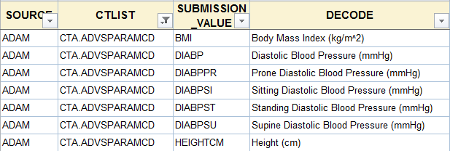
Controlled Terminology for PARAM
There is no industry wide controlled terminology for ADaM parameters (yet)
Many sponsors are creating their own to support internal standards development
Lilly is ahead of the curve – Refer to Global Library

Slide 40
AVAL and AVALC
As noted, AVAL and/or AVALC represent the value of PARAM
Original intent was to have AVAL OR AVALC
But if both are populated, then need to be 1:1
Useful for parameters where numeric score can be equated to a character description, e.g., questionnaires
AVAL | AVALC
1 | Seldom
2 | Often

Slide 41
BASE and BASEC
Fundamentally, BASE is just a given AVAL at a time point designated as baseline
BASE is added as a column primarily when it is needed for the calculation of functions of AVAL, such as change from baseline
Because BASE is just a particular example of AVAL, same rules as for AVAL apply to BASE and BASEC

Slide 42

Functions of BASE and AVAL
Columns that are functions of AVAL and BASE can be added
CHG – change from baseline
PCHG – percent change from baseline
R2BASE – ratio of AVAL / BASE

Slide 43

Categorical Variables
There are many use cases where analysis requires categorization of continuous values of AVAL, BASE, CHG, PCHG
There can be more than one way to categorize a given variable
AVALCATy, BASECATy, CHGCATy, PCHGCATy
SHIFTy is used to describe a shift from baseline

Slide 44

Quick Visual Recap
Subject Identifiers
STUDYID, USUBJID, SUBJID
Analysis Parameter Variables
PARAM/PARAMN/PARAMCD
AVAL/AVALC
Functions of AVAL
BASE/BASEC, R2BASE
CHG/PCHG
Categorical Variables
AVALCATy, BASECATy, CHGCATy, PCHGCATy, SHIFTy
Company Confidential ©2015 Eli Lilly and Company
Notes:
AVAL does not have to be the value used for an analysis. It often is but other columns also may be the focus of an analysis

Slide 45
Indicator Variables

Slide 46
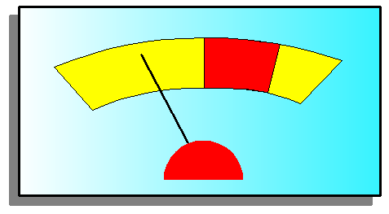
Indicator Variables
An Indicator Variable is a flag variable that is used to convey something important about a given record
*FL is the suffix used for character indicator (flag) variables with *FN used for numeric companion variable if needed
Values for character indicator variables are Y, N, or null
We discussed population flag variables in ADSL but there are many indicator variables defined for use in BDS

Slide 47
Indicator Variables - ABLFL
Flagging the record that contains the value of baseline provides traceability, is required and may be useful for programming
Sponsor decision on whether to populate values of CHG on records that are at baseline or prior to baseline
USUBJID | PARAMCD | AVAL | BASE | CHG | ABLFL
123-1001 | GLUCOSE | 143 | 122 | ?
123-1001 | GLUCOSE | 122 | 122 | ? | Y
123-1001 | GLUCOSE | 138 | 122 | 16
123-1001 | GLUCOSE | 153 | 122 | 31

Slide 48
Indicator Variables - Criteria
Analyses may require indication of whether a pre-specified criteria was met on a given record
For example, was a Glucose value of “< 120” achieved?
ADaM has a set of paired variables for this purpose
CRITy , MCRITy = text description of criteria
CRITyFL, MCRITyML = indication of whether this criteria was met on the given record
CRITy and CRITyFL are used for binary criteria allowable values of CRITyFL are Y/N/null
MCRITy and MCRITyML are used for multinomial criteria and allowable values of MCRITyML are sponsor defined

Slide 49
Indicator Variables – Criteria
Both paired variables must be present
CRITy and CRITyFL can be populated on every record or only on the ‘Y’ records
PARAMCD | AVAL | BASE | CHG | CRIT1 | CRIT1FL | CRIT2 | CRIT2FL
GLUCOSE | 122 | 122 |  | Glucose<120 | N
GLUCOSE | 115 | 122 | -7 | Glucose<120 | Y
GLUCOSE | 138 | 122 | 16 | Glucose<120 | N
GLUCOSE | 153 | 122 | 31 | Glucose<120 | N | CFB >20 | Y

Slide 50
Lilly Module 4: Exercise #2
Materials Needed:
ADaM IG and go to section 3.3
Lilly Module 4 Exercise.xls
Read paragraph in column A that is an excerpt from a prototype SAP. Consider the parameters that need to be defined and the additional variables that need to be present on the row in order to analyze the data as stated. Enter your proposed values of PARAM and the additional variables (concepts or variable names) in individual columns (Hint: there are 5 variable concepts to consider)

Slide 51
Lilly Module 4 - Exercise #2
Let’s do the first question together (column B).
How many parameters would this dataset have?

Slide 52
Lilly Module 4 - Exercise #2
Section 10.6.3 Vital signs of heart rate, respiration, diastolic and systolic pressure will be summarized by each planned clinic visit. All vital signs will be summarized using the observed value for each visit and the change from baseline. For diastolic blood pressure, additional analyses will present the frequency counts at each visit for the following three categories of diastolic pressure, >0 to 85, >=85 to 95, and >=95. Additional presentation of frequency counts will be shown using the following two categories of diastolic pressure: >. to <90 and >=90. For systolic blood pressure, the count of subjects who experienced a systolic pressure greater than 160 at any time during the study will be presented. Frequency counts will be presented for the following two categories of systolic pressure: .> to 130; >=130 | How many parameters would this analysis dataset have?

Slide 53
Module 4 - Exercise #2 Answers
How many parameters would this analysis dataset have? | For each of these parameters, create text for PARAM | For each of these parameters, create text for PARAMCD
4 | PARAM | PARAMCD
 | Heart Rate (beats / min) | HR
 | Respiration (breath/min) | RESPIR
 | Systolic Blood Pressure (mmHg) | SYSBP
 | Diastolic Blood Pressure (mmHg) | DIASBP

Slide 54
Module 3 - Exercise #2 Answers (Con’t)
For each of these parameters, create text for PARAMCD | Assume this column is for AVAL | In these columns, enter the variable name that would need to be present in order to analyze each of the paramters. Supply example values where possible.
PARAMCD | AVAL | BASE | CHG | AVALCAT1 | AVALCAT2 | CRIT1 | CRIT1FL
HR | 65
RESPIR | 34
SYSBP | 165 |  |  | >=130 |  | Systolic Pressure >160 | Y
DIASBP | 94 |  |  | >=85 TO <95 | >=90

Slide 55
Module 4 Summary
ADaM defines standard variables that can appear in any non-ADSL dataset, such as treatment variables and timing variables
Source variables from SDTM may be retained to support data point traceability
BDS is a flexible structure that centers around the concept of an analysis parameter
The value of the analysis parameter is contained in the required variables of AVAL and/or AVALC
BDS has additional columns that can be added, all of which relate to the analysis parameter

Slide 56
End of Lilly Module 4 ☺

